Slide 1
AutoMobIns App
Protect your Assets…
Youtube Video : http://youtu.be/C9jZ95HnK2U

Slide 2
Index
Assumptions and User Story
Automobins App Technical Details
App Features
Replicate Automobins App Settings in to your Salesforce Instance

Slide 3
Assumptions and User Story
Assumptions
Automobins is a Auto Mobile Insurance company offers insurance to the auto mobiles.
Automobins have a well developed Insurance Management system running on salesforce.com.
Customer Contacting for claiming Insurance
When customers of Automobins meet with an accident, they claim for the insurance by calling the customer support of Automobins Company.
Customer Support Executive will assign the claim investigation to any of the available Insurance Field Executive in their Insurance Management System.
Insurance Field Executive can login to Automobins App from anywhere to see his/her task(claims) for today.
Insurance Field Executive can update the task(claims) assigned to him/her and can upload the picture of the incident(accident/damages of the vehicle) in to the Insurance management system running in salesforce.com using the the App.
Geo location of the accident location will be pushed into Insurance Management System when ever Insurance Field Executive updates task(claims) using the App.
Insurance Field Executive can also see all the previous claims investigated by him/her using the App.
Insurance Field Executive can also contact support for any enquiry using the App.
Automobins App User Story Starts here…

Slide 4
Index
Assumptions and User Story
Automobins App Technical Details
App Features
Replicate Automobins App Settings in to your Salesforce Instance

Slide 5
Automobins App – Technical Details
Automobins App is a hybrid mobile app
Currently Available only for Android Platform(since it is hybrid it is possible to make it available for other platform using the same code base).
App is designed using HTML5, Jquery Mobile, CSS3, Phonegap.
App also use the Utilities provided by Salesforce like forcetk, SalesforceOAuthPlugin, SFHybridApp for accessing SFDC.

Slide 6
Index
Assumptions and User Story
Automobins App Technical Details
App Features
Replicate Automobins App Settings in to your Salesforce Instance

Slide 7
Automobins App Features
Menu (Navigation Menu)
Graphical representation for easily identify today’s task
All Claims/Todays Claim(assignned to the executive)
Detail Page of Insurance Claims
Call Customer Option from Claim Details Page
Contact Executive Support help line

Slide 8
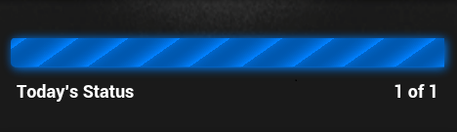
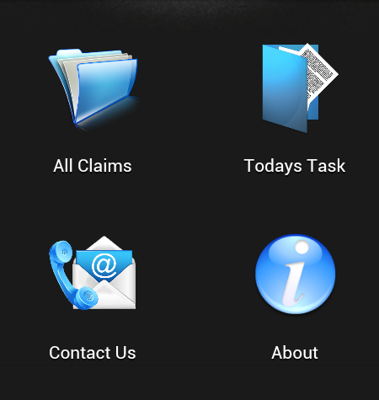
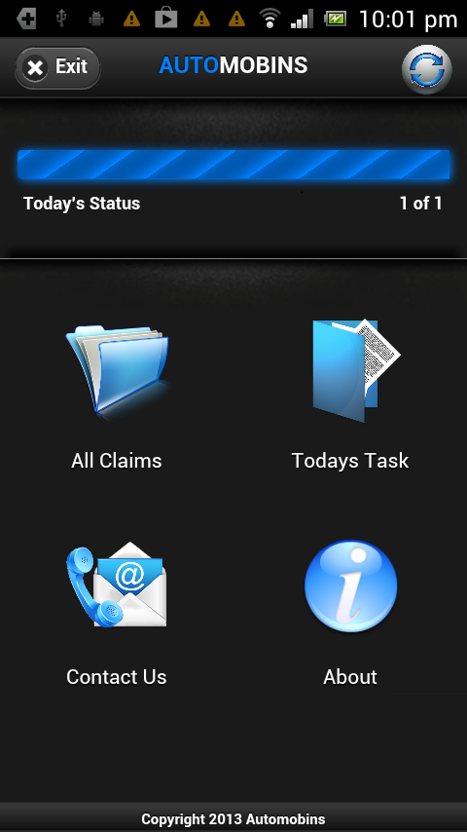

Automobins App – Features
Navigation Menu for easy navigation across available features.
Navigation Menu Screen
Graphical representation for easily identify today’s task
Get the lastest updates by clicking on refresh button
Logout from the app using the exit button

Slide 9
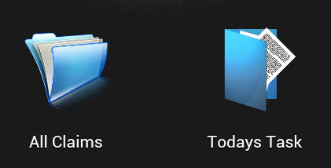

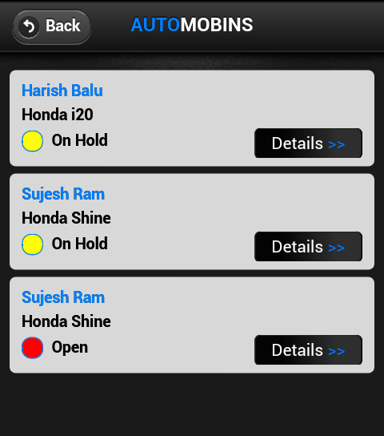
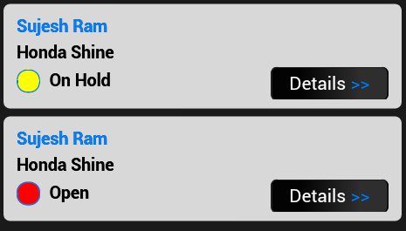
Automobins App – Features
Back button to go back to Navigation Screen
Details of the claims
All Claims/Todays Claim Screen
Click Details to view/update a claim

Slide 10
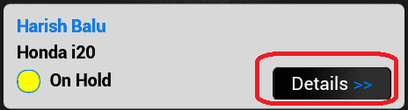
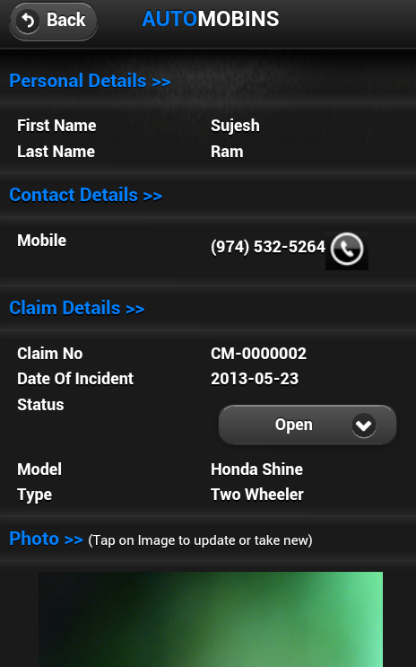
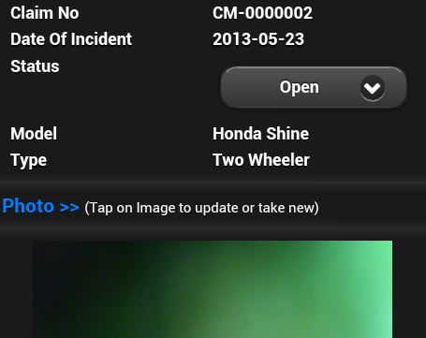

Automobins App – Features
Back button to go back to Navigation Screen
Tap on Image to call the customer
Claim Details Screen
Select list to update the claim status
Click cancel to go back to claim list page
Click submit to update claim
Tap on Image to capture new picture

Slide 11
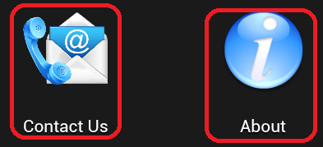
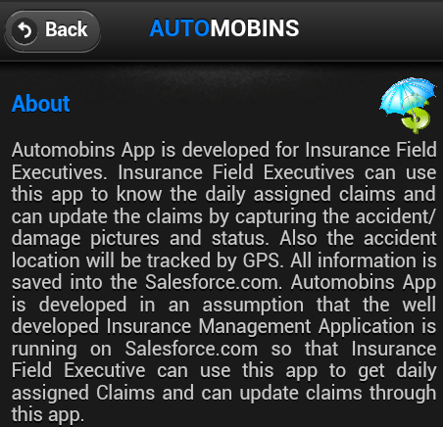
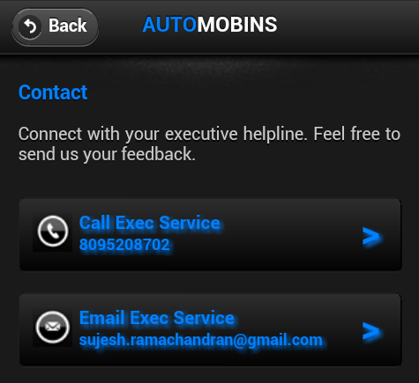
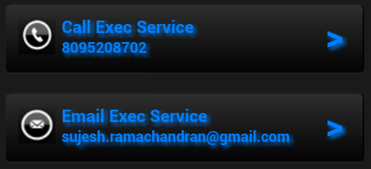
Automobins App – Features
Back button to go back to Navigation Screen
About Screen
Contact Us Screen
Click on Phone image to contact Insurance Executive Support via Phone
Click on Email image to contact Insurance Executive Support via Email

Slide 12
Index
Assumptions and User Story
Automobins App Technical Details
App Features
Replicate Automobins App Settings in to your Salesforce Instance

Slide 13

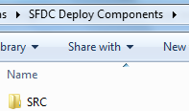
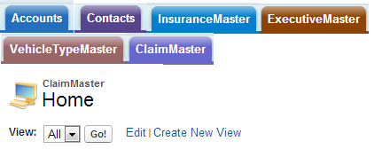
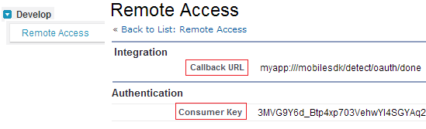
Replicate Automobins App in to your Salesforce Instance
Salesforce Side Settings
Download the github repository
https://github.com/sujeshramachandran/automobins
Goto codebase → SFDC deploy Components folder and deploy the SRC folder into your salesforce instance and open your salesforce instance
Insert a new Account and a new Contact under the above Account
Insert a new record into InsuranceMaster , ExecutiveMaster, VehicleTypeMaster and ClaimMaster
Goto Develop → Remote Access and create a new Remote Access OR goto Create → App → Connected Apps.
After creating the Remote Access, note down the Callback URL and auto generated Consumer Key

Slide 14

Replicate Automobins App in to your Salesforce Instance
App Code Base Settings
Now from the downloaded folder, Goto codebase → Android Code Base Folder
Import the AutomobinsApp into your Eclipse Workspace
From Eclipse, goto Assets → www → bootconfig.js
Update variable remoteAccessConsumerKey as Consumer Key and oauthRedirectURI as Callback URL of Remote Access created earlier in salesforce
Build the App and Install into your device.

Slide 15
Thank you -Sujesh RAMACHANDRAN

